Slide 1

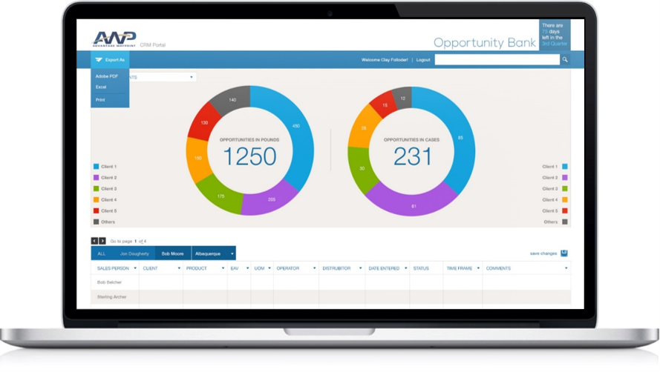
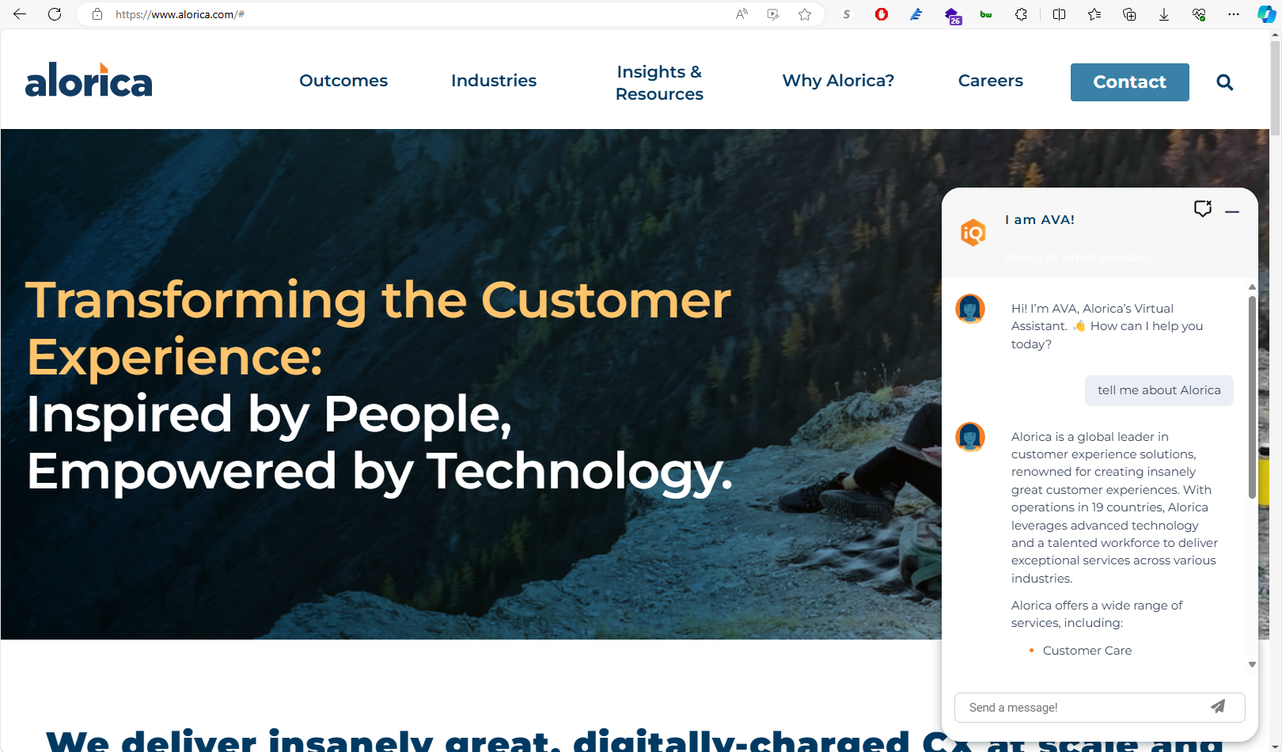
Alorica – Website and Sales AI Agents
Business Need
Alorica wanted to improve how prospective customers discover information on their public website and convert interest into qualified leads. In parallel, Sales and Operations teams needed a faster, more consistent way to respond to RFPs without manually searching through historical proposals and internal documentation.
What We Did
Implemented a customer-facing AI chatbot on Alorica’s public website to answer common questions, guide visitors to relevant services, and support lead generation
Built an internal AI assistant to help Sales and Operations teams generate RFP responses using Alorica’s historical RFP library and approved company content
Integrated both agents with proprietary data sources and applied governance controls to ensure accuracy, consistency, and approved messaging
Enabled real-time voice-to-text interaction, allowing users to speak questions and receive immediate AI-generated responses.
Results
Increased website engagement by providing immediate, contextual answers to prospective customers
Reduced time and effort required to produce RFP responses by enabling teams to retrieve accurate answers in seconds
Improved consistency and quality of customer-facing messaging and sales proposals at scale
Expanded accessibility and usability through voice-driven interactions, supporting faster engagement and hands-free workflows.

Slide 2

Alorica – AI Website Chat Bot & RFP Assistant
Business Need
Alorica came to Affirma for support developing two key AI experiences for their customers and internal teams:
A customer-facing chat bot on their public website to answer questions and guide site visitors to the right information.
An AI Assistant to support Sales and Operations teams with RFP creation by providing key company information and answers to questions from their historical RFP library.
What We Did
Affirma developed Python tools to ingest and understand the client’s data set, including website contents and company documents. These tools converted the data into chunk storage in a vector database, where inputs could be fuzzy-searched.
Front-end chat bot widgets were developed to be embedded on any HTML page, supporting both text and audio input/output using state of the art AI text-to-speech.

